Slide 1
Competitive Algorithm Calculation Testing in a Unified System
(C.A.C.T.U.S.)
Acceptance Test
Presented By:
ExoNET Solutions
04/25/2012

Slide 2
Welcome
Dr. Darren Lim
Associate Professor of Computer Science
Siena College

Slide 3
Agenda
Introductions
Problem Overview
Solution Strategy
Testing Overview
Unit Tests
Integration Tests
Performance Test
Functional/ Nonfunctional Requirements
Demonstration
Deliverables
Timeline
Conclusion
What is next for ExoNET?
ExoNET Solutions – Acceptance Test

Slide 4
ExoNET Solutions Team Members
Stephanie Del Belso
Team Leader
David Purcell
Lead Programmer
Thomas Delaney
Database Admin/ System Admin
Marco Samaritoni
Testing Manager
Paul Amodeo
Web Master/ Interface Expert

Slide 5
Agenda
Introductions
Problem Overview
Solution Strategy
Testing Overview
Unit Tests
Integration Tests
Performance Test
Functional/ Nonfunctional Requirements
Demonstration
Deliverables
Timeline
Conclusion
What is next for ExoNET?
ExoNET Solutions - Acceptance Test

Slide 6
Problem Overview
Current contest system is loosely structured
Inconvenient for judges and contestants
Not easily maintained
Not fully automated

Slide 7
Agenda
Introductions
Problem Overview
Solution Strategy
Testing Overview
Unit Tests
Integration Tests
Performance Test
Functional/ Nonfunctional Requirements
Demonstration
Deliverables
Timeline
Conclusion
What is next for ExoNET?
ExoNET Solutions - Acceptance Test

Slide 8
Solution Strategy
Defined and obtained requirements
Design development
Implementation/coding
Testing solution
Maintenance

Slide 9
Agenda
Introductions
Problem Overview
Solution Strategy
Testing Overview
Unit Tests
Integration Tests
Performance Test
Functional/ Nonfunctional Requirements
Demonstration
Deliverables
Timeline
Conclusion
What is next for ExoNET?
ExoNET Solutions - Acceptance Test

Slide 10
Testing - Overview and Strategy
Testing consists of multiple test cases for each type of user in the system
These tests are used to measure the overall performance of the system
Tests include: Unit Test, Integration Test, System Test, Performance Test and Acceptance Test

Slide 11
Agenda
Introductions
Problem Overview
Solution Strategy
Testing Overview
Unit Tests
Integration Tests
Performance Test
Functional/ Nonfunctional Requirements
Demonstration
Deliverables
Timeline
Conclusion
What is next for ExoNET?
ExoNET Solutions - Acceptance Test

Slide 12
Unit Tests
Serve as the backbone of the Test Plan
Based on the functionality of a single component of the system
Comprised of many Test Cases, which are individual members of a Unit Test

Slide 13
Agenda
Introductions
Problem Overview
Solution Strategy
Testing Overview
Unit Tests
Integration Tests
Performance Test
Functional/ Nonfunctional Requirements
Demonstration
Deliverables
Timeline
Conclusion
What is next for ExoNET?
ExoNET Solutions - Acceptance Test

Slide 14
Integration Test
Tests how well different components of C.A.C.T.U.S interact with each other
Each individual component must first have a successful Unit Test

Slide 15
Agenda
Introductions
Problem Overview
Solution Strategy
Testing Overview
Unit Tests
Integration Tests
Performance Test
Functional/ Nonfunctional Requirements
Demonstration
Deliverables
Timeline
Conclusion
What is next for ExoNET?
ExoNET Solutions - Acceptance Test

Slide 16
Testing – Performance Test
Test done on April 12th 2012
Ensured that C.A.C.T.U.S. functions with up to 40 users
The nature of this project requires that the system be able to handle traffic from a large number of users

Slide 17
Agenda
Introductions
Problem Overview
Solution Strategy
Testing Overview
Unit Tests
Integration Tests
Performance Test
Functional/ Nonfunctional Requirements
Demonstration
Deliverables
Timeline
Conclusion
What is next for ExoNET?
ExoNET Solutions - Acceptance Test

Slide 18
Functional/Non-Functional Requirements
Describes the requirements specified by the client
Used for defining the scope of the project
Used as pass/fail criteria

Slide 19
C.A.C.T.U.S.’s Functional Requirements
Communication between judge and contestant
Usable in multiple web browsers
Run/host programming contests
Process problem submissions

Slide 20
Non-Functional Requirements
Specifies criteria that can be used to judge the operation of a system
C.A.C.T.U.S.’s requirements:
User friendly
Scalability

Slide 21
Agenda
Introductions
Problem Overview
Solution Strategy
Testing Overview
Unit Tests
Integration Tests
Performance Test
Functional/ Nonfunctional Requirements
Demonstration
Deliverables
Timeline
Conclusion
What is next for ExoNET?
ExoNET Solutions - Acceptance Test

Slide 22
Demonstration
C.A.C.T.U.S.

Slide 23
Agenda
Introductions
Problem Overview
Solution Strategy
Testing Overview
Unit Tests
Integration Tests
Performance Test
Functional/ Nonfunctional Requirements
Demonstration
Deliverables
Timeline
Conclusion
What is next for ExoNET?
ExoNET Solutions - Acceptance Test

Slide 24
Deliverables
A CD-ROM will be given to Dr. Lederman
On April 30th 2012 containing:
A full copy of ExoNET’s files associated with C.A.C.T.U.S.
All project source code and Javadocs
Team song with lyrics

Slide 25
Agenda
Introductions
Problem Overview
Solution Strategy
Testing Overview
Unit Tests
Integration Tests
Performance Test
Functional/ Nonfunctional Requirements
Demonstration
Deliverables
Timeline
Conclusion
What is next for ExoNET?
ExoNET Solutions - Acceptance Test

Slide 26
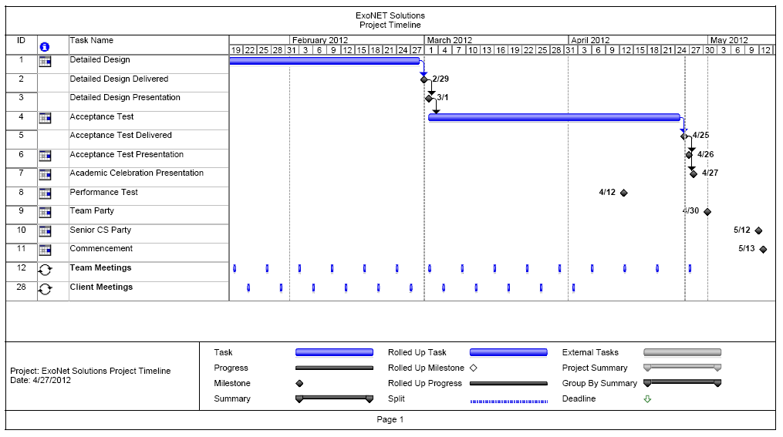
Timeline

Slide 27
Agenda
Introductions
Problem Overview
Solution Strategy
Testing Overview
Unit Tests
Integration Tests
Performance Test
Functional/ Nonfunctional Requirements
Demonstration
Deliverables
Timeline
Conclusion
What is next for ExoNET?
ExoNET Solutions - Acceptance Test

Slide 28
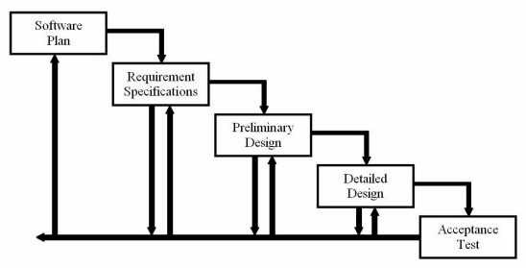
Waterfall Model
Development
and
Testing
Acceptance
Test

Slide 29
Agenda
Introductions
Problem Overview
Solution Strategy
Testing Overview
Unit Tests
Integration Tests
Performance Test
Functional/ Nonfunctional Requirements
Demonstration
Deliverables
Timeline
Conclusion
What is next for ExoNET?
ExoNET Solutions - Acceptance Test

Slide 30
What is next for ExoNET?
Academic Celebration Demonstration – April 27th 2012
Software Party – April 30th 2012
Senior CS Party – May 12th 2012
Graduation! – May 13th 2012 & December 2012

Slide 31
Thank You.
Questions? Comments?

